Slide 1
Beta Presentation Switch Alignment Mobile Game
Team Union Pacific
Jiayue Chai
Zack Joyce
Alexa Kelley
Mike Walton
Daniel Wylie
Department of Computer Science and Engineering
Michigan State University
Spring 2023

Slide 2
Project Overview
A game to train Union Pacific employees to identify different switch alignments.
Designed for Android and browser platforms with first-person view and realistic simulations.
Infinite runner style with scoring feature and leaderboard.
Include various challenging conditions such as nighttime and snowy weather.

Slide 3
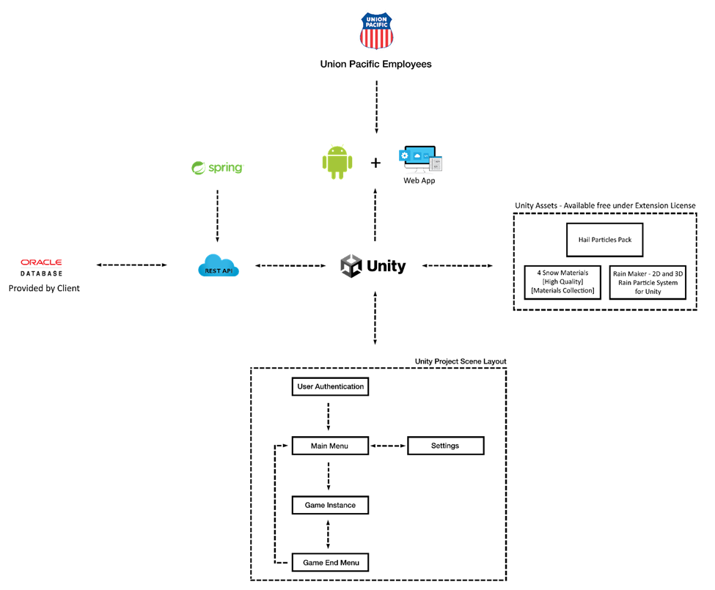
System Architecture

Slide 4
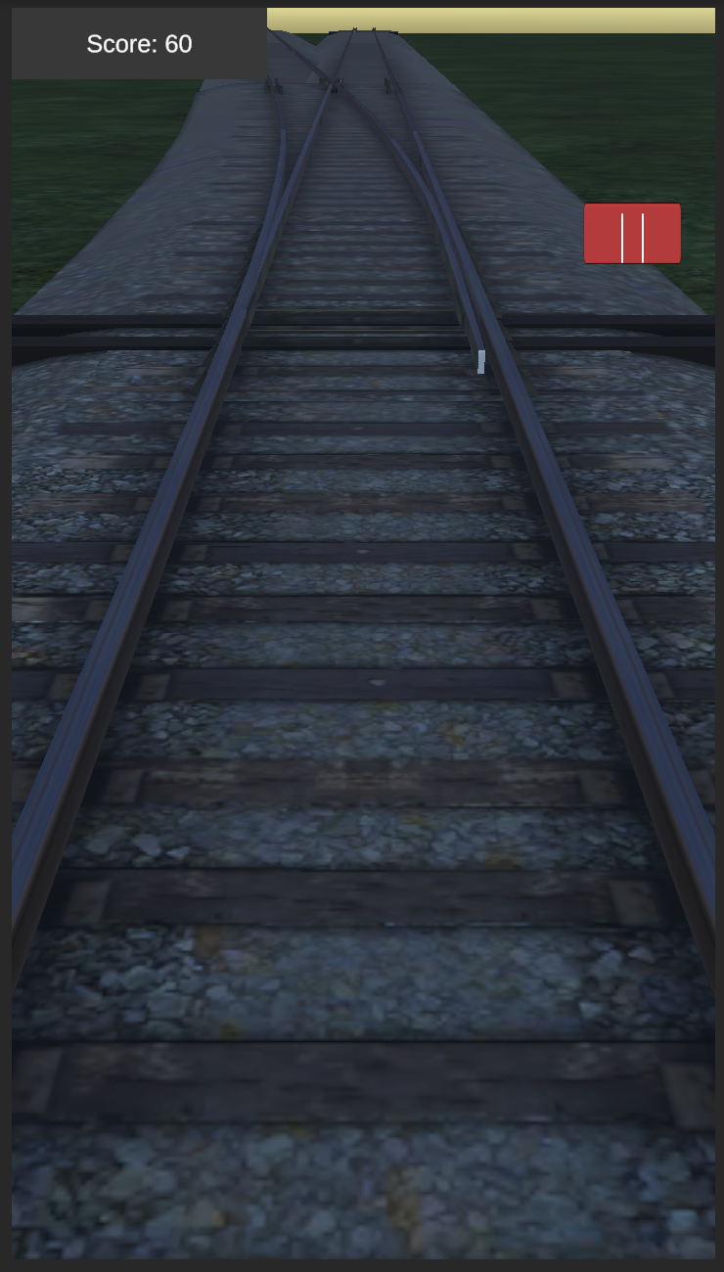
Morning Gameplay

Slide 5
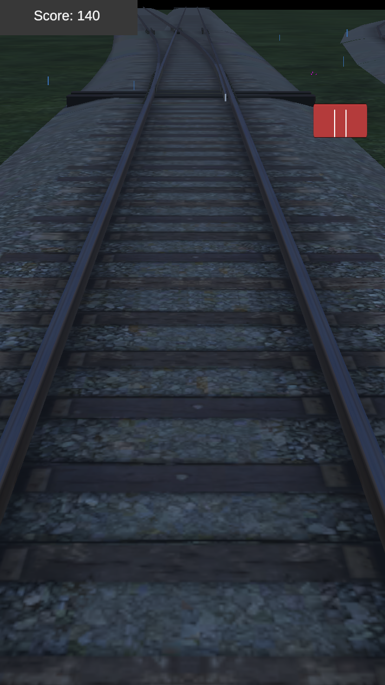
Night Gameplay

Slide 6
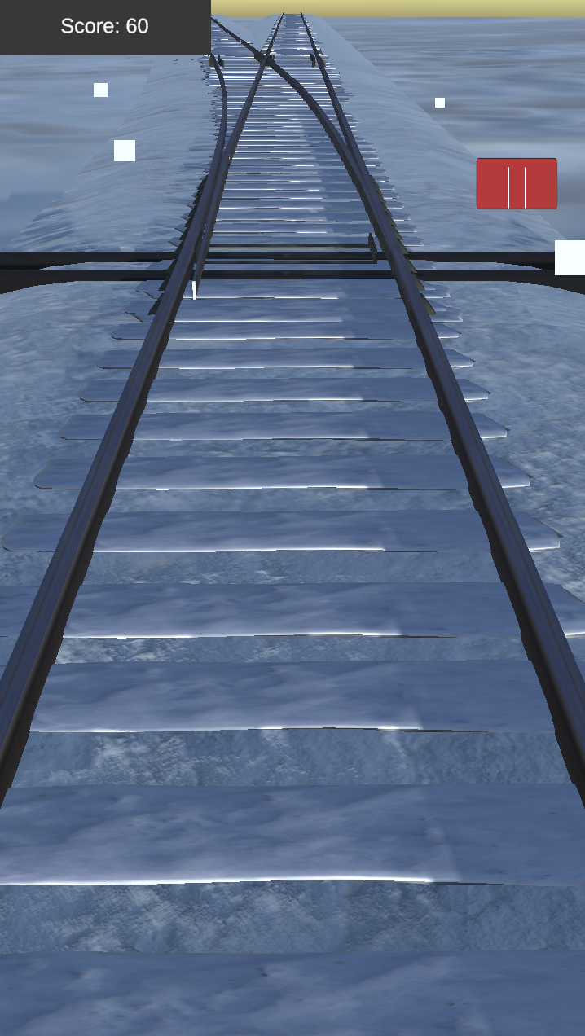
Snow Environment Gameplay

Slide 7
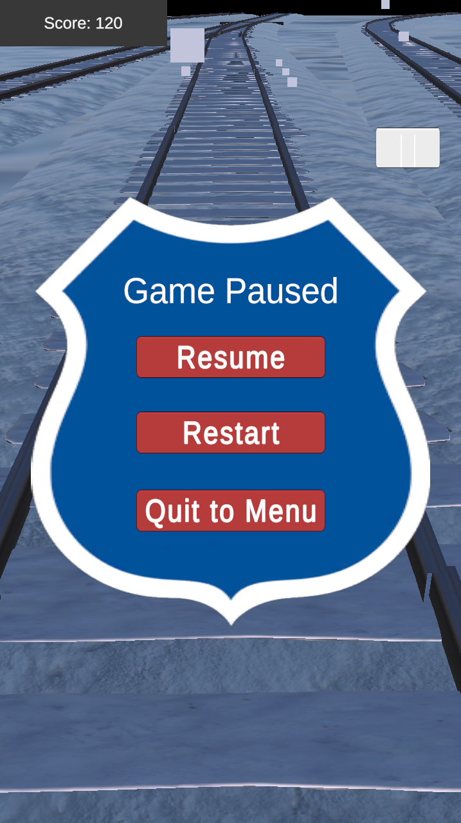
Pause Menu

Slide 8
What’s left to do?
Features
Stretch Goals
Practice mode: personalize weather/speed in settings.
Practice mode: personalize switch types in settings.
Add more scenery.
Other Tasks
Clean UI.
Adjust terrain generation.
Adjust the camera angle.
Increase the speed over time.
Blur the screen while paused.

Slide 9
Questions?
?
?
?
?
?
?
?
?
?

